Slide 1
-Effective Advocacy and Services
-Quality Assurance in Program Offerings
2017 PSM Initiatives
and Unified Pricing Model
March 1, 2017
Presenters:
- Courtney Thornton, NPSMA President
- Jim Sterling, PSM National Office Faculty Director
Notes:
COURTNEY
Good afternoon.
My name is Courtney Thornton, and in January, I began serving as president of the National Professional Science Master’s Association or NPSMA.
I’m joined today by Faculty Director of the PSM National Office, Jim Sterling.
We are so pleased that you have joined us.
We are excited to give you an overview of several initiatives underway or being planned for 2017, and we will talk in-depth about one change to your annual invoice that results in every PSM program having improved access to information and services.
This is a pre-recorded video message and not an interactive webinar, but you can submit questions to us anytime about anything you hear in it. In fact, we encourage it, because your questions can help us plan follow-up webinars and improve our FAQ webpages.
Before we get started, we know that many watching today will, up to this point, have been more familiar with either the NPSMA or with the PSM National Office.
These two entities have distinct roles but are tightly interconnected.
The NPSMA strives to provide effective advocacy and services for PSM leaders, while the National Office manages the quality assurance efforts.

Slide 2
-Effective Advocacy and Services
-Quality Assurance in Program Offerings
NPSMA
BOARD OF DIRECTORS
PSM NATIONAL OFFICE
STEERING COMMITTEE
AND
WORKFORCE ADVISORY COUNCIL
Notes:
COURTNEY
This slide gives a quick overview of PSM leadership.
As you can see with a quick glance at these logos, our PSM leadership draws from a wide range of universities and partners across the nation and around the world.
The NPSMA is governed by a Board of Directors.
The NPSMA Board actively listens to its members, and this has resulted in an exciting change to the Board for 2017. Two new executive-level positions have been added to elevate our focus and attention on Member Benefits and Marketing and Outreach. We expect to see quick results from this focused attention.
The NPSMA also convenes a Workforce Advisory Council (WAC) comprised of industry leaders like those found on PSM program advisory boards.
The PSM National Office engages a Steering Committee to guide its work on quality assurance.
With that background, let us kick off the video by sharing a few exciting things in store for 2017.

Slide 3
-Effective Advocacy and Services
-Quality Assurance in Program Offerings
Completion of single, improved website for PSM information
Notes:
COURTNEY
We hope you have already noticed and benefited from several improvements to the website. It has a modernized, clean look, improved access to program information, and a new domain name (www.professionalsciencemasters.org).
But, information about PSMs still exists across a number of websites. We are very close to finishing the efforts to unify those websites under this single domain, making your search for information easier and more efficient.

Slide 4
-Effective Advocacy and Services
-Quality Assurance in Program Offerings
?
Updated logo and tagline for improved marketing
We’ll start by asking your input as to what association name best represents our membership and purpose?
Then, we’ll ask you to enlist your talented schools, departments, and students in a contest for a tagline and modernized logo.
Notes:
COURTNEY
Did you know that NPSMA turns 10 this year?
Did you also know that in addition to U.S. institutions, PSM programs have been affiliated in Australia, Korea, and the United Kingdom?
And, were you aware of past efforts to grow Professional Master’s programs in Social Sciences and Humanities?
The 10-year mark provides an excellent time to think about where we’ve been and where we’re going – and to make sure that we have identifiers for our community that help us effectively convey our purpose and vision.
You’ll be hearing from us later this year for your thoughts on our association name, and those results will inform a contest to develop a new tagline and logo with prizes and recognition for winning entries. So, stay tuned!

Slide 5
-Effective Advocacy and Services
-Quality Assurance in Program Offerings
Transition one INNOVATOR issue to a curated NPSMA publication
Notes:
COURTNEY
The Innovator is NPSMA’s newsletter. It was reinvigorated in 2016 in an effort to put timely and valuable information into member hands. This year we plan to take it one step further by having at least one Innovator issue be a peer-reviewed, curated publication.
PSM programs are on the leading edge of efforts to better integrate graduate-level disciplinary content and research skills with the professional skills that are attractive to employers.
Many of you take a scholarly approach to designing and delivering PSM programs and to understanding student and employer outcomes.
We want to communicate what you learn from those approaches to your peers and other stakeholders in higher education, industry, and government.
As a peer-reviewed, curated publication, the Innovator will become the vehicle that allows our community to do this.
We know that the opportunity to publish in the Innovator will quickly be regarded as a key benefit for our members.

Slide 6
-Effective Advocacy and Services
-Quality Assurance in Program Offerings
NPSMA 8th National Conference
Phoenix, AZ
November 9-10, 2017
Pre-conference workshop on Marketing
“Build, Sustain, Grow” thematic sessions
Celebrate 10-year anniversary of NPSMA, and
20-year anniversary of first Sloan awards to develop PSMs
Notes:
COURTNEY
2017 marks a milestone year for the PSM community.
It is the 20-year anniversary of the first Sloan Foundation grants to develop PSMs and the 10-year anniversary of the NPSMA.
It will be a special year, indeed, at the national meeting, and we hope you are already making plans to attend.
The pre-conference workshop will keep with our increased focus on marketing, and the conference itself will look broadly at how we build, sustain, and grow PSMs for the future.

Slide 7
-Effective Advocacy and Services
-Quality Assurance in Program Offerings
Data Collection and Dissemination
Enrollment and Degrees Assessment Report (2016)
PSM Alumni Outcomes (2015/16)
Visit Reports and Statistics at
www.professionalsciencemasters.org
Notes:
JIM
Good afternoon everyone. The PSM National Office is responsible for the quality-control functions of the PSM initiative. We administer the Affiliation Application and Review of PSM programs on a 5-year cycle. We also collect data to create reports on enrollment and degrees and PSM Alumni Outcomes. We encourage you to visit the Reports and Statistics page at www.professionalsciencemasters.org.
In 2017, the PSM National Office will produce two reports: the Enrollment and Degrees Assessment Report that is based on the reporting that PSM-granting institutions provide. Each affiliated PSM program has committed to provide this data as part of the PSM Affiliation. We do appreciate your timely response to our data requests and are willing to facilitate communications with campus Institutional Research if that is needed to ensure accurate reporting. Additionally, the PSM Alumni Outcomes Report is now a bi-annual report that is based on surveys of PSM alumni from the most recent 3 years. This spring, you will see the report for the survey of 2014, 2015, and 2016 graduates. We look forward to posting these reports to the PSM website shown here this Spring and hope that they provide data that you need to support marketing to internal campus constituencies and well as for recruiting students.

Slide 8
-Effective Advocacy and Services
-Quality Assurance in Program Offerings
Unified Pricing Model
Notes:
COURTNEY
I hope you are as excited as we are about these 2017 initiatives.
As we mentioned, the NPSMA is turning 10 this year. I happen to have a 10-year old at home right now and so I am keenly aware of the amazing amount of skill and knowledge that is gained in 10 short years. Even things that you learned to do at 7 or 8 years old – like riding a bike, tying lace shoes, cutting with a knife – you perform these tasks with considerably more skill at 10 years old.
This next portion of the video is just such an example – it is our organization getting more skilled at how we function operationally as we turn 10 years old.
At this point, we are going to transition to talk in-depth about a new unified pricing model and how it will be implemented.
Again, we strongly encourage you to send us any questions about the unified pricing model. These questions will be collected and responses will be added to our existing FAQ page.

Slide 9
-Effective Advocacy and Services
-Quality Assurance in Program Offerings
What is changing, and why?
Beginning this year, institutions with PSM-affiliated programs must be members of NPSMA.
This better aligns the PSM community with the practices of other similar communities that have both member services and quality assurance functions (e.g. American Chemical Society, American Psychological Association, etc.)
355
PSM programs at
165
Institutions,
but only
37
NPSMA member institutions
…equals an opportunity to vastly strengthen the PSM community.
Notes:
JIM
I’m pleased to describe what is changing and why. In short, beginning this year, all institutions with PSMs undergoing Affiliation Review, including institutions applying for their first PSM Affiliation, must be members of the NPSMA.
We began these efforts in earnest about two years ago. We realized that many PSM programs were affiliated but had no connection to the NPSMA member organization that provides services, advocacy, professional development, and other benefits to the PSM community. Some institutions have paid for multiple years of affiliation fees, but those fees did not have any connection to the member organization, the NPSMA.
This historical practice has created a disconnect that keeps the PSM community from coming together as a whole and using its full capacity for the benefit of the community. Many other organizations that provide both membership and quality assurance, like APA or ACS, ensure a close coupling of those functions. As you see in the numbers on the right, only one quarter of the institutions offering PSMs are currently involved in the member-supporting activities of the NPSMA. Imagine how differently – and how much better - we can serve existing and future PSMs if 100% of those institutions were connected?
So, in short, we needed to take steps to ensure that all PSM-granting institutions join together as a full and vibrant professional community, and we know you will see increased benefits from this.
That means a close coupling of the associated dues and fees as well.
Our efforts to strengthen the connections between affiliation and NPSMA membership quickly led us to see the opportunity to simplify the cost structure and invoice for each institution. That’s the unified pricing model that will be presented today.

Slide 10
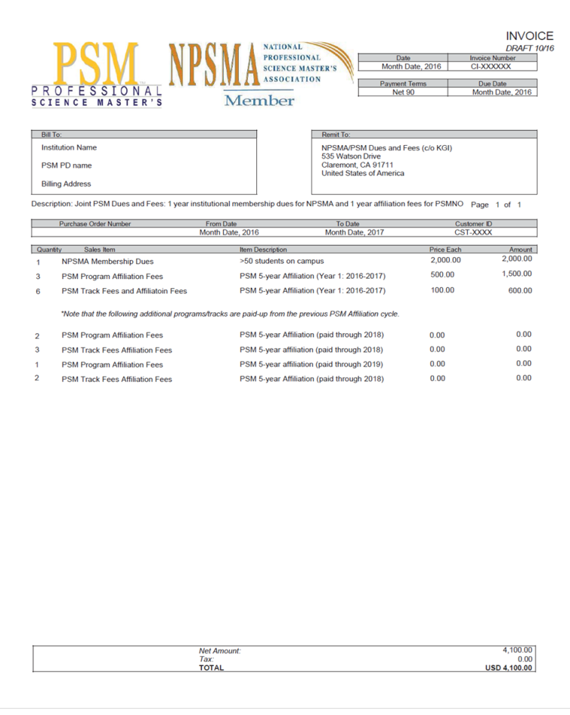
-Effective Advocacy and Services
-Quality Assurance in Program Offerings
So, what differences should I notice?
You will receive a single invoice for NPSMA dues and affiliation fees. Clean and simple.
All institutions with PSMs will now be ensured access to NPSMA member benefits.
Institutions with affiliated PSM programs that have not been engaged in NPSMA may see an increase in your annual invoice; but these annual costs will still be more affordable than other similar models we’ve explored.
Notes:
JIM
So, what differences will you notice?
First, when you next seek PSM Affliation Review, your institution will receive a single invoice that includes both NPSMA dues and PSM program affiliation fees.
And, you will see a significant increase in the information and services you receive and can benefit from.
Because we have several institutions that have been engaged with the PSM National Office for affiliation or with the NPSMA but not both, you may see an increase in your annual invoice. We also took this opportunity to look at other organizations that offer accreditation or similar recognition of degree programs in STEM and related areas. This work helped us to confirm that the unified pricing model remains, in comparison, very affordable for our community.

Slide 11
-Effective Advocacy and Services
-Quality Assurance in Program Offerings
The Unified Pricing Model
Institutional membership dues are a sliding scale based on total PSM program enrollments at the institution.
<10 PSM students $500/year
10-49 PSM students $1000/year
50+ PSM students $2000/year
System memberships (minimum 6 institutions) are discounted 25%.
Affiliation fees are $500 annually per program.
For PSMs with tracks, the affiliation fee for the first track is $500 and then $150 annually per additional track.
Notes:
JIM
I’m going to walk us through the new unified pricing model and a couple of examples of what a typical institution may pay under the new model.
First, the membership dues are a sliding scale based on total PSM program enrollments at an institution. The scale was iteratively-developed over the past year and a half by the NPSMA and the National Office by considering comparable small professional membership associations and quality-control organizations in graduate education. Careful attention was paid to making this affordable while working to ensure that both NPSMA and the National Office can operate sustainably and deliver good benefits to the community.
Systems, defined as at least six institutions having an affiliated PSM program, are eligible for a 25% discount on the membership dues.
To give a bit of perspective, ATS annual membership dues are $1000-$7000 depending on budget (<$2M to >$5M). For Pharmacy Schools the dues are much higher as AACP annual institutional memberships are $26k/year.
Then, PSM program affiliation fees will be assigned on an annual basis even though the programs are affiliated for 5 years. Affiliation fees are $500 per year per program. For PSMs with tracks, the affiliation fee for the first track is $500 annually and then $150 annually for the remaining tracks.

Slide 12
-Effective Advocacy and Services
-Quality Assurance in Program Offerings
The Unified Pricing Model – Affordable QA Fees
QA fees over five years for a PSM program with 10-49 students enrolled
Current Model
Unified Pricing Model
Applied Science Program Accreditor*
Year 1 $300
Year 2 $300
Year 3 $300
Year 4 $300
Year 5 $300
TOTAL $1500
Average $300/year
Year 1 $500
Year 2 $500
Year 3 $500
Year 4 $500
Year 5 $500
TOTAL $2500
Average $500/year
Year 1 $650
Year 2 $650
Year 3 $650
Year 4 $650
Year 5 $650
Year 6 $10,000
TOTAL $13,250
Average $2,200/year
*Quoted by accreditor in 2016
Notes:
JIM
Affiliation fees cover costs such as administrative services for affiliation and review; reports and statistics on enrollment, degrees, and outcomes; and certificates of graduation. In this new model, a program’s affiliation fees will increase from $300 to $500 per year, for a total of $2500 over five years.
In comparison, a well known accreditor of applied science degree programs charges each program an annual maintenance fee of $650 plus nearly $10,000 for each accreditation review cycle. Averaged out, the accredited degree program is paying $2200 per year.
So again, our aims were to align with other similar initiatives and cover costs while keeping the fees very affordable.

Slide 13
-Effective Advocacy and Services
-Quality Assurance in Program Offerings
The Unified Pricing Model – Typical PSM Institution
More than 50% of all PSM programs up for 2017 Affiliation Review are the only PSM program at their institution
and have 10-49 students PSM students enrolled.
$1000 institutional membership dues
1 x $500 annual affiliation fee
$1500 total annual invoice
Notes:
JIM
The majority of programs up for 2017 affiliation review are the only PSM program at that institution and has somewhere between 10 and 49 students enrolled. This is our simplest example of what a typical invoice will look like.
The $1000 membership dues is the scale for 10-49 students enrolled.
The PSM program has an annual affiliation fee of $500, making the total annual invoice for this institution $1500.

Slide 14
-Effective Advocacy and Services
-Quality Assurance in Program Offerings
The Unified Pricing Model – Example with Multiple Programs
Our campus has 3 PSM programs with 10-49 total students enrolled.
Only 1 PSM program is due for Affiliation Review in 2017.
$1000 institutional membership dues
3 x $500 annual affiliation fee
- 2 x $500 annual affiliation fee for Programs 2-3 (CREDIT)
$1500 total annual invoice
NOTE: The Credit is shown for the cost that the 2 programs will begin paying once their Affiliation Reviews are completed.
Notes:
JIM
What if we have 3 PSM programs on campus, with a total of 10-49 students enrolled, but only one program is up for 2017 affiliation review?
The membership dues of $1000 are at the scale for 10-49 students enrolled.
The invoice will show the annual affiliation fee for all programs – in this example there are 3 total programs - but it will also credit the annual affiliation fees for any programs that are not up for affiliation review in 2017 – in this example there are 2 of those programs.
Another way to think about this is that, when all three of this institution’s programs have gone through affiliation review, then the institution can expect an annual invoice amount of $2500.

Slide 15
-Effective Advocacy and Services
-Quality Assurance in Program Offerings
The Unified Pricing Model – Example with Tracks
Our campus has a PSM program with 5 tracks
and 10-49 students enrolled.
Only Tracks 1 and 2 are due for Affiliation Review in 2017.
$1000 institutional membership dues
1 x $500 annual affiliation fee for Track 1
4 x $150 annual affiliation fee for Tracks 2-5
- 3 x $150 annual affiliation fee for Tracks 3-5 (CREDIT)
$1650 total annual invoice
NOTE: The Credit is shown for the cost that the 3 tracks will begin paying once their Affiliation Reviews are completed.
Notes:
JIM
What if we have a single PSM program with five affiliated tracks and a total of 10-49 students enrolled, but only two of the five tracks are up for 2017 affiliation review?
Again, the membership dues of $1000 are at the scale for 10-49 students enrolled.
The invoice will show the annual affiliation fee for all tracks. The annual affiliation fee for the first track in a multi-track program is $500, while the annual affiliation fees for the remaining tracks in the program are $150.
Just as in the previous example, the invoice will credit the annual affiliation fees for any tracks that are not up for affiliation review in 2017 – in this example there are 3 such tracks.
Another way to think about this is that, when all five of this institution’s tracks have gone through affiliation review, then the institution can expect an annual invoice amount of $2100.

Slide 16
-Effective Advocacy and Services
-Quality Assurance in Program Offerings
The Unified Pricing Model – FAQ
Notes:
JIM
We have started a FAQ page at www.professionalsciencemasters.org with a few questions that we have already anticipated.
For example: How do we know when a PSM program at our institution is due for Affiliation Review?
Answer: Upcoming affiliation dates are listed on program pages on www.professionalsciencemasters.org.
(e.g. see https://www.professionalsciencemasters.org/psm-programs/saint-marys-college .) If your program does not show this information yet, please contact psmoffice@sciencemasters.com.
As another example, there is a question as to whether an institution can just keep affiliating its programs without joining NPSMA?
The answer is no. The new approach ensures that all participating PSM-granting institutions receive benefits of both NPSMA membership and the PSM program affiliation.
Or, can we join NPSMA but not have an affiliated program?
The answer is no. The answer is that an institution must have an affiliated program to be a member. But, NPSMA will continue to provide individual memberships that allow other interested stakeholders to remain involved.
Please contact us with any further questions so that we can enhance our FAQ page with responses to your questions.

Slide 17
-Effective Advocacy and Services
-Quality Assurance in Program Offerings
What will trigger an institution coming
under the new unified pricing model?
An existing affiliated PSM program or track at your institution is due for affiliation review
OR
A new PSM program becomes affiliated
Notes:
JIM
What will trigger an institution coming under the new unified pricing model?
For existing PSMs, single invoicing for NPSMA membership and PSM affiliation will begin whenever your institution has a PSM program up for affiliation review. PSMs at nearly 60 institutions are up for review in 2017. You will begin hearing from us soon, and you can always check your affiliation date status on our website.
All new PSMs will begin under the unified pricing model.
We are working hard to make sure the single invoice is implemented smoothly. And, implementation won’t be complete until all programs move through one affiliation cycle. So, thanks for sticking with us.

Slide 18
-Effective Advocacy and Services
-Quality Assurance in Program Offerings
THANK YOU!
Email at
npsma@npsma.org
Notes:
COURTNEY
Thanks, Jim.
Again, we are so pleased that you joined us today and hope you found this webinar informative. Please submit any remaining questions now in the chat area, or you can always contact us at npsma.org.
We are excited to work with you on these upcoming initiatives, and until we connect again soon, we wish you and your students all the best in your spring semesters!

